Slide 1

TEACHING OBJECTIVES
1. Familiarize students with the key elements of deployment including timing, licensing and compatibility, pricing, distribution, and marketing.
2. Provide students with an understanding of the analyses that should be conducted when deciding on a deployment strategy.

Slide 2
Overview
A large part of the value of a technological innovation is determined by the degree to which people understand and use it.
An effective deployment strategy is thus a key element in a technological innovation strategy.
Some of the key elements of an effective deployment strategy include timing, licensing and compatibility, pricing, distribution, and marketing.

Slide 3

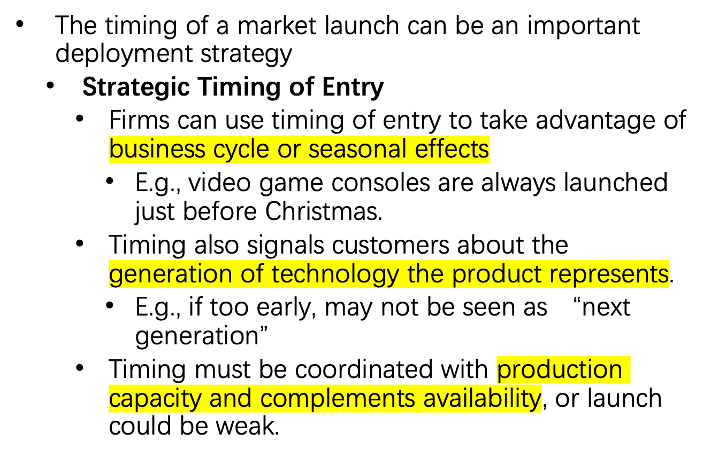
Timing

Slide 4
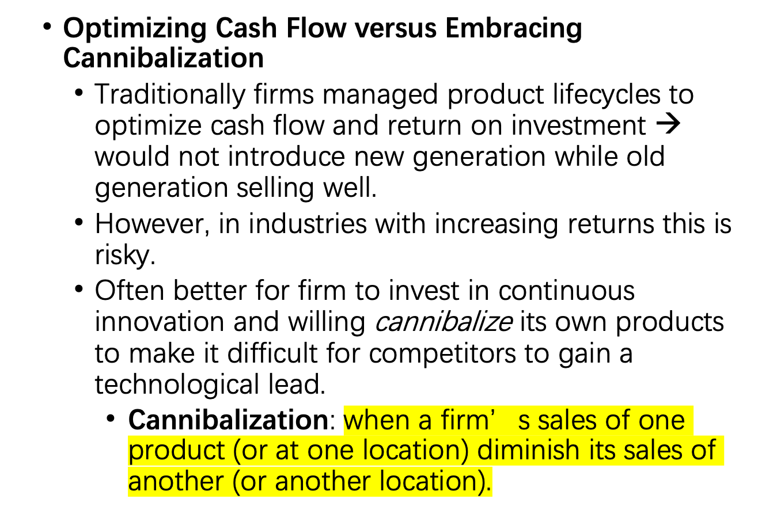
Timing Continued

Slide 5

Licensing and Compatibility
  Protecting a technology too little can result in low quality complements and clones; protecting too much may impede development of complements.
  Firm must carefully decide:
    How compatible to be with products of others
      If firm is dominant, generally prefers incompatibility with others’ platforms but may use controlled licensing for complements.
      If firm is at installed base disadvantage, generally prefers some compatibility with others and aggressive licensing for complements.
    Whether to make product compatible with own previous generations (“backward compatibility”)
      If installed base and complements are important, backward compatibility usually best – leverages installed base and complements of previous generation, and links generations together. Can be combined with incentives to upgrade.

Slide 6
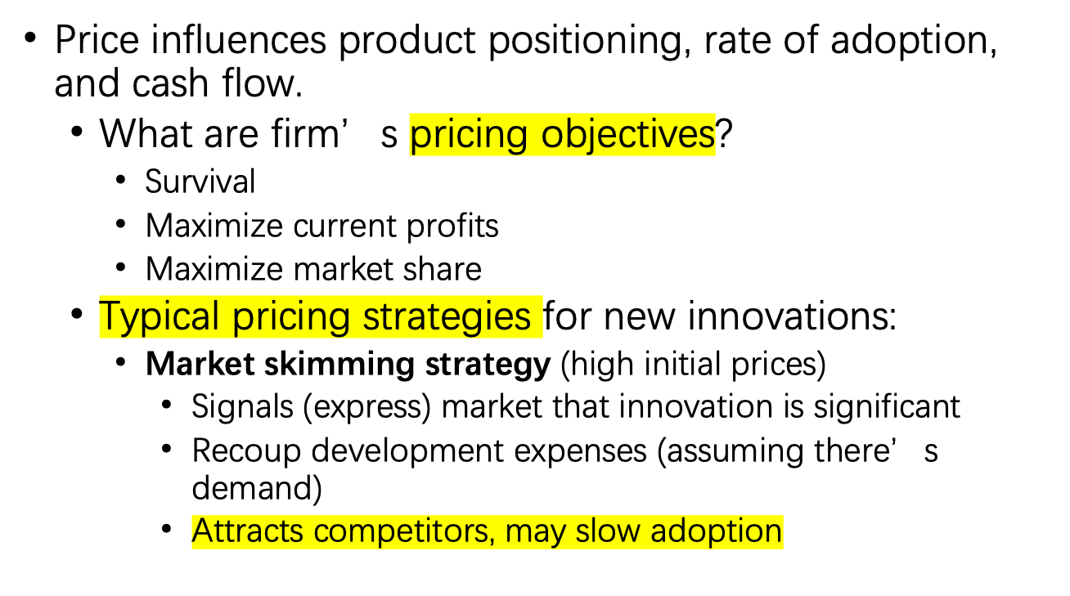
Pricing

Slide 7
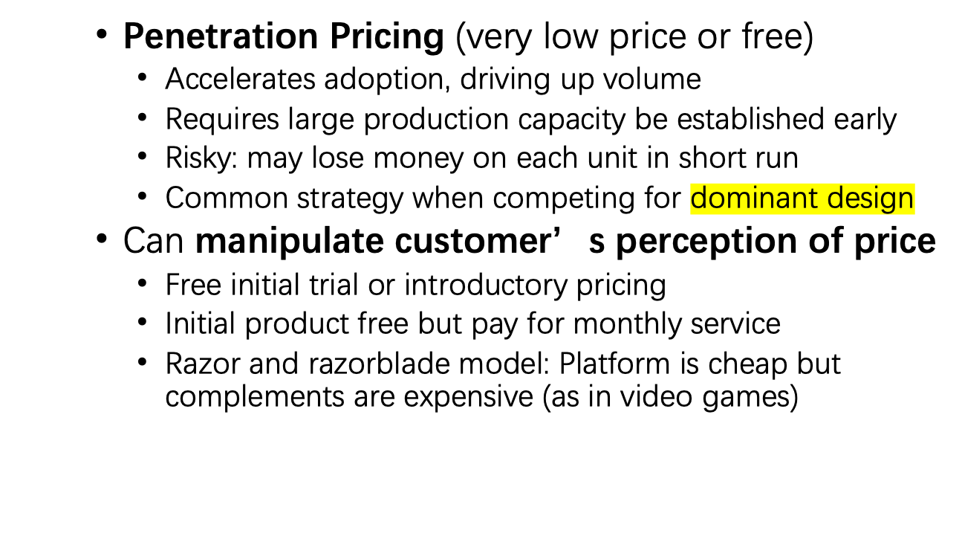
Pricing Continued

Slide 8

Distribution
Selling Direct versus Using Intermediaries
  Selling direct
      Gives firm great control over selling process, price and service
      Can be expensive and/or impractical
  Intermediaries may include:
    Manufacturers’ representatives: independent agents that may promote and sell the product lines of one or a few manufacturers.
    Wholesalers: firms that buy manufacturer’s products in bulk then resell them (typically in smaller, more diverse bundles)
      Provide bulk breaking and carry inventory.
      Handles transactions with retailers and provides transportation.
    Retailers: firms that sell goods to public
      Provide convenience for customers

Slide 9

Distribution Continued
    Original equipment manufacturers (OEMs):
      A company that buys products (or components) from other manufacturers and assembles them or customizes them and sells under its own brand name. E.g., Dell Computer
      Aggregates components from multiple manufacturers
      Provides single point-of-contact and service for customer
  In some industries, information technology has enabled disintermediation or reconfiguration of intermediaries.
      E.g., online investing enables customers to bypass brokers; online bookselling requires retailer to provide delivery services.

Slide 10
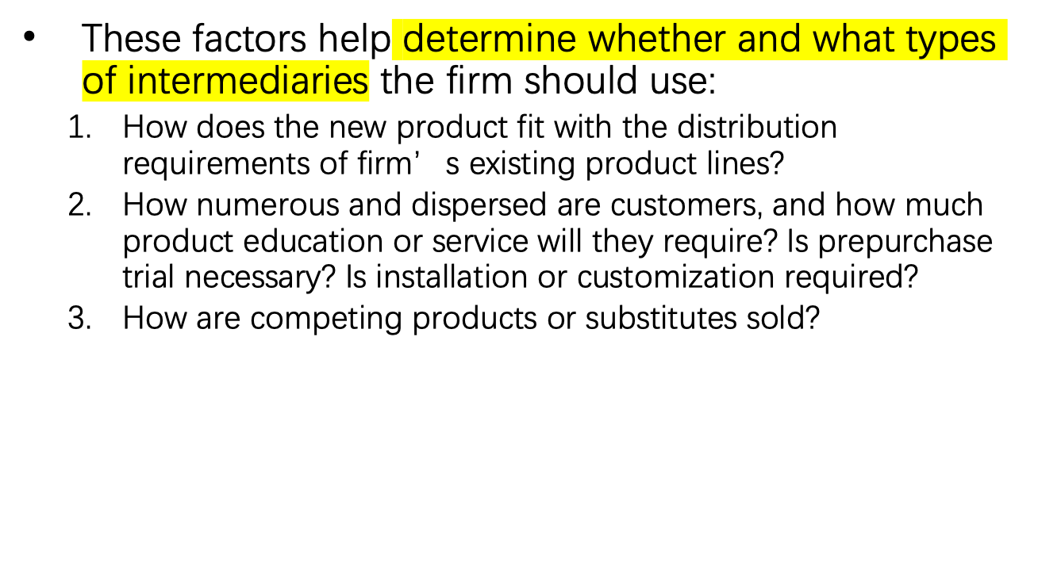
Distribution Continued

Slide 11
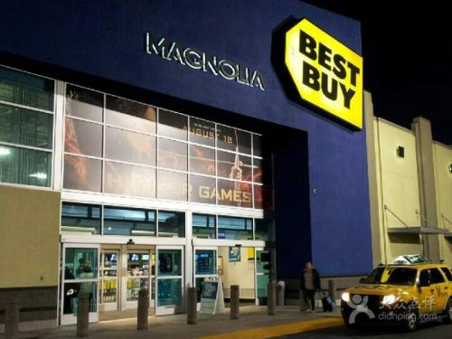
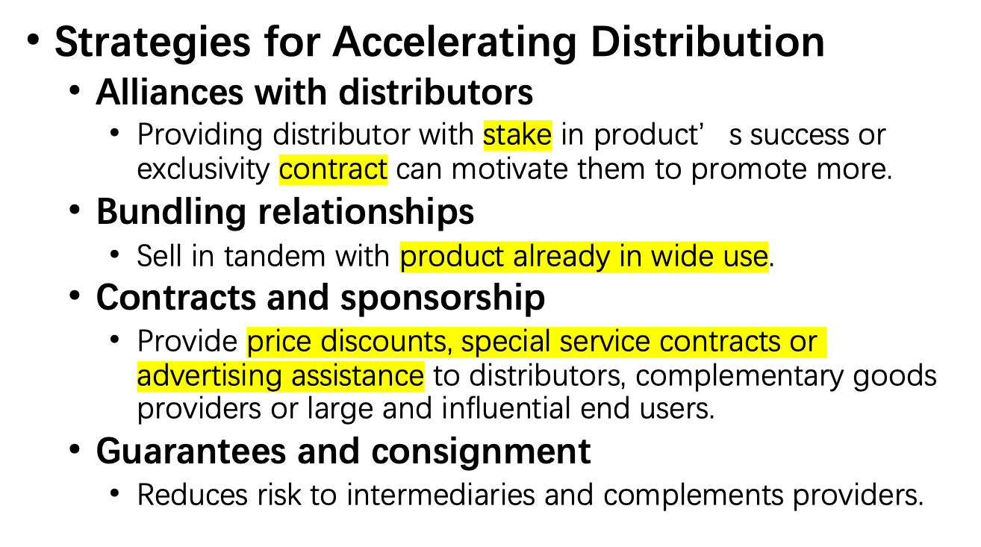
Distribution Continued

Slide 12
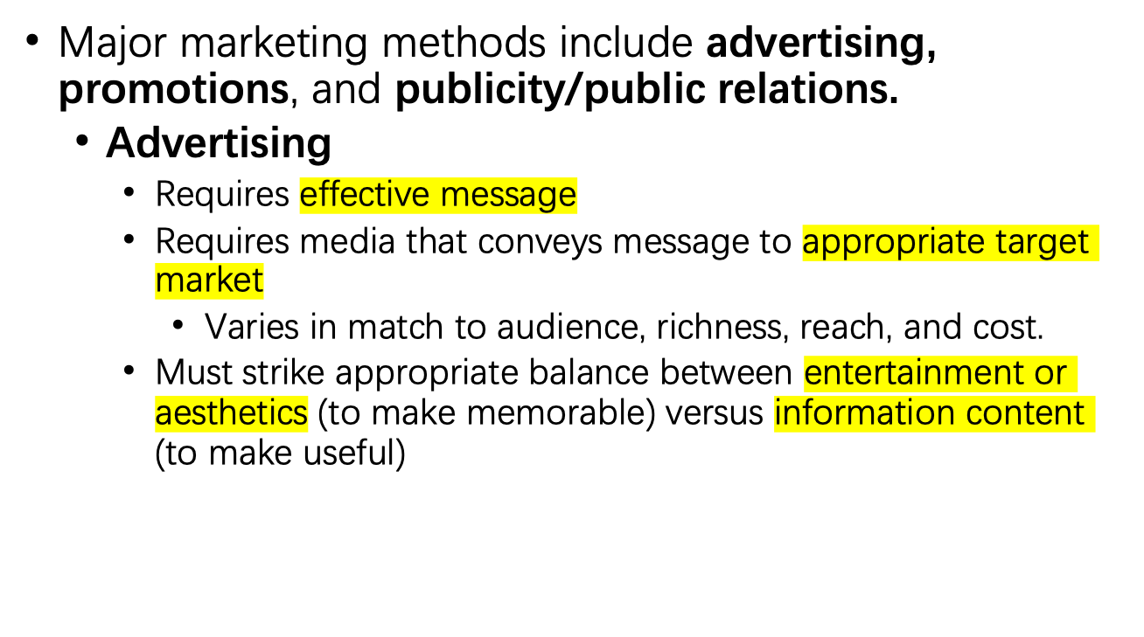

Marketing

Slide 13
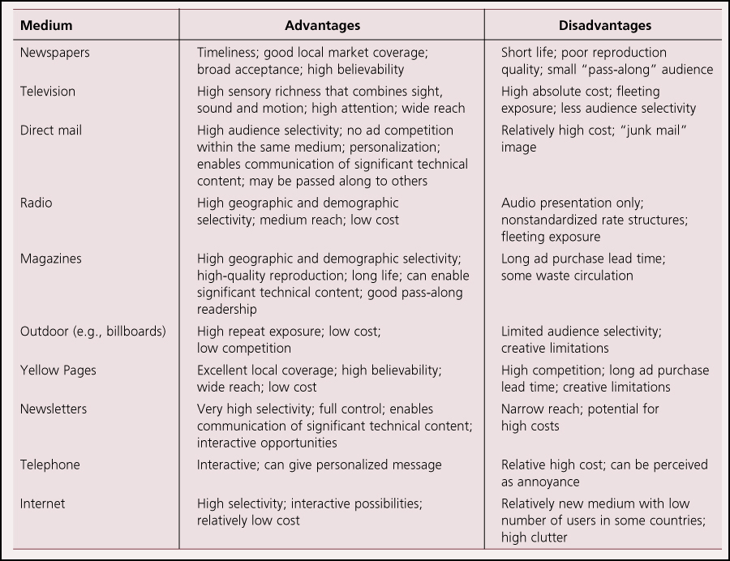
Marketing Continued
Advantages and Disadvantages of Major Advertising Media

Slide 14
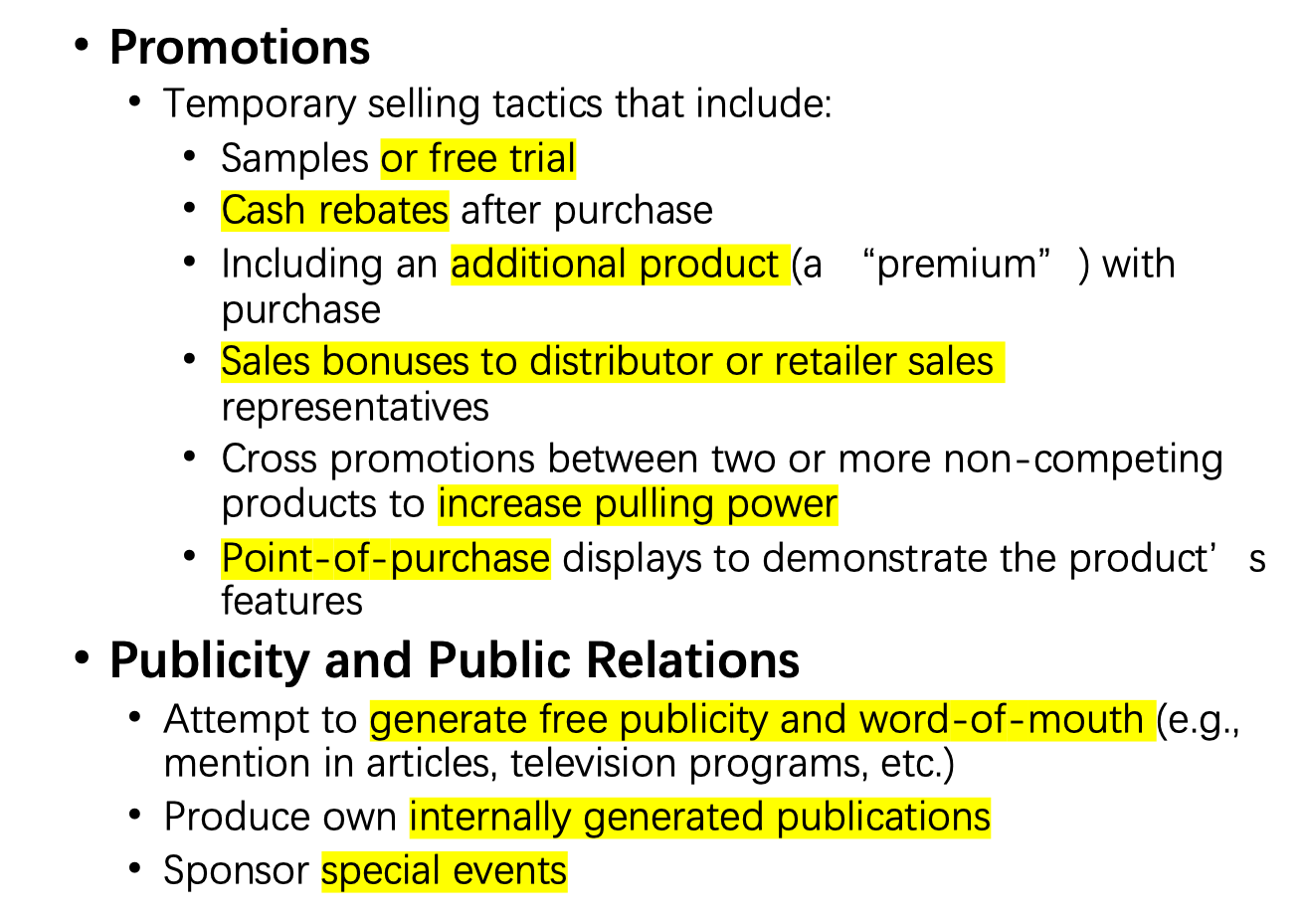
Marketing Continued

Slide 15
Theory In Action
Generating Awareness for Domosedan
  Farmos wanted to build awareness of its new innovation in animal painkillers.
  Asked university professors and advanced practitioners to help with testing process for drug – acted as premarketing tool.
  Drug was featured in conferences, articles, dissertations.
  Farmos also hosted a large dinner party for all practicing veterinarians at the drug’s launch.
  Domosedan was adopted rapidly around the world and became a commercial success.

Slide 16
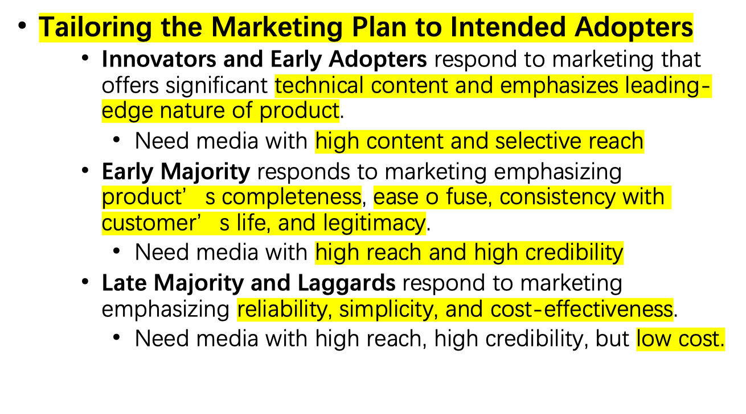
Marketing Continued

Slide 17

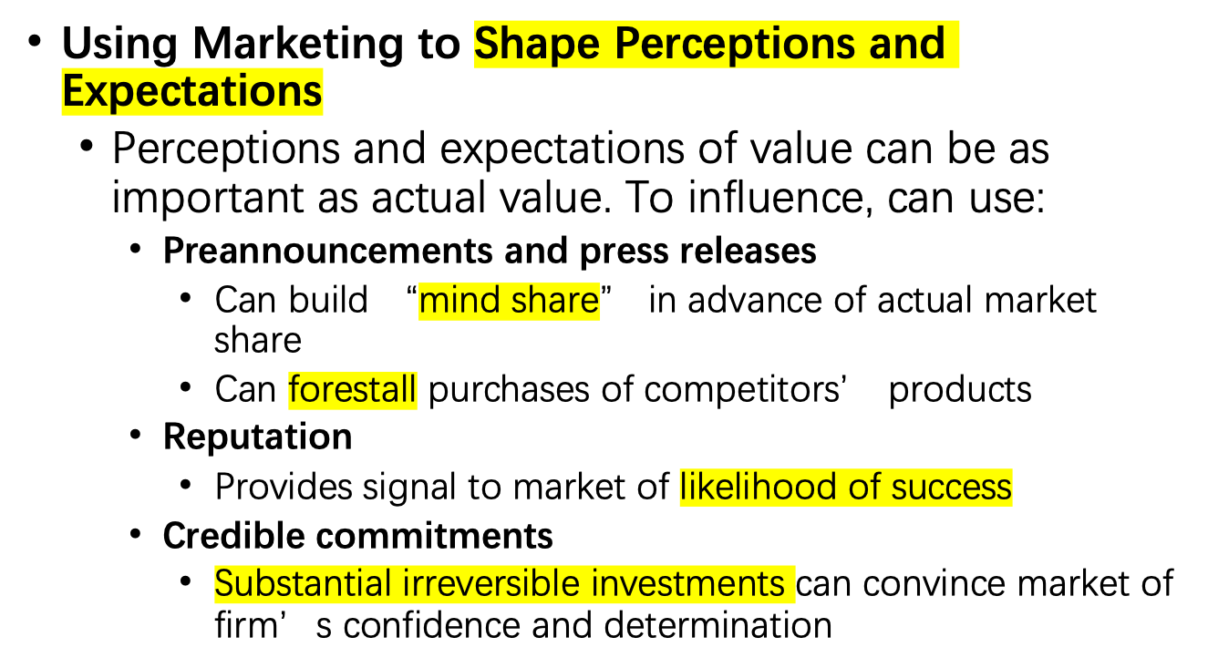
Marketing Continued

Slide 18
Research Brief
Creating an Information Epidemic
  Gladwell notes that some individuals have a disproportionate impact on marketplace behavior:
    Connectors
      Have exceptionally large and diverse circle of acquaintances
      Knack for remembering names and important dates
    Mavens
      Driven to obtain and disseminate knowledge about one or more of their interests
      Will track prices, tend to be consumer activists
      Take great pleasure in helping other consumers
    Salespersons
      Naturally talented persuaders
      Acute ability to send and respond to nonverbal cues; can infect others with their mood!

Slide 19
Discussion Questions
Can you identify one or more circumstances when a company might wish to delay introducing its product?
What factors will (or should) influence a firm’s pricing strategy?
Pick a product you feel you know well. What intermediaries do you think are used in bringing this product to market? What valuable services do you think these intermediaries provide?
What marketing strategies are used by the producers of the product you identified for question 3? What are the advantages and disadvantages of these marketing strategies

